Slide 1

Instagram Analytics Using SQL
A deep dive into Instagram performance data with SQL, developed during the Virtual Internship. This project extracts key insights for engagement, content performance, and audience growth.
VS
by Viraj Shah

Slide 2

In this project, I carried out six main types of analysis:
Descriptive Analysis – to summarize impressions, reach, likes, and new followers.
Comparative Analysis – to evaluate how different post types perform.
Time Series Analysis – to identify trends across months, weekends, and quarters.
Categorical Analysis – to assess which content categories (like Mobile, Tech Tips) perform best.
Engagement Analysis – focusing on likes, comments, saves, and shares.
Automation – by creating a stored procedure to auto-generate weekly share reports.
Each of these supports the goal of optimizing content strategy and increasing audience interaction.
VS

Slide 3

Understanding Our Dataset
Our analysis leverages three core tables to provide a holistic view of Instagram performance:
dim_date: Contains calendar fields like month, weekday/weekend, week number, and quarter, enabling time-based analysis.
fact_account: Tracks daily profile visits and new follower counts, vital for audience growth metrics.
fact_content: Details post categories and types, along with key metrics such as likes, comments, saves, reach, and impressions.

Slide 4
Unique Instagram Post Types
To understand the diversity of our content strategy and identify the various formats used on Instagram, we queried the fact_content table to list all distinct post types. This insight is crucial for analyzing content performance and optimizing future posting strategies.
SELECT distinct post_type From fact_content;
This SQL query allows us to pinpoint the unique categories of posts, providing a clear overview of the content formats that have been published.

Slide 5
Unique Instagram Post Types
IG Image
IG Reel
A single static image post.
Short-form vertical video content.
IG Carousel
IG Video
A post with multiple images or videos that users can swipe through.
Longer-form video content.

Slide 6
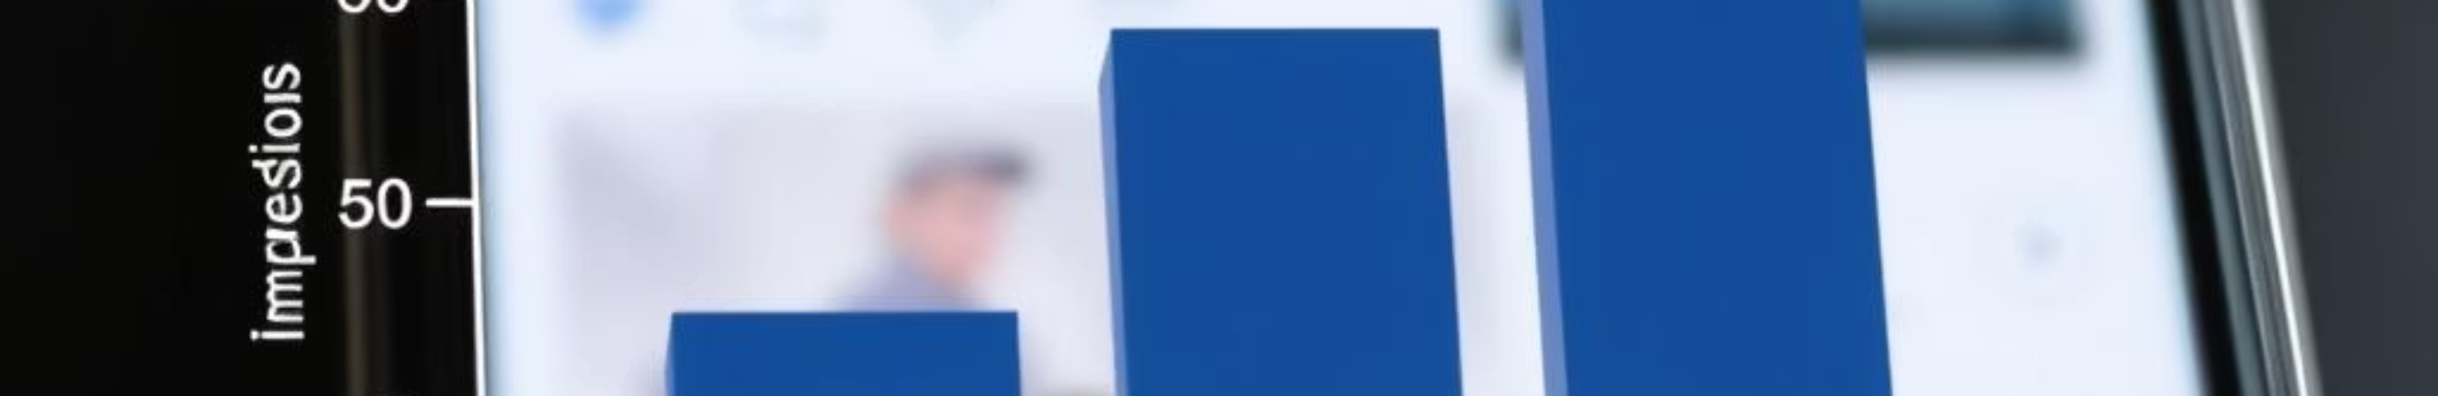
Content Type Insights
Identifying the variety of content types and their performance allows us to optimize future content strategies.
Impression Range per Type
Understanding the highest and lowest impressions for each post type highlights content variability and potential for optimization.
SELECT post_type, MAX(impressions) AS max_impressions, MIN(impressions) AS min_impressionsFROM fact_contentGROUP BY post_type;

Slide 7
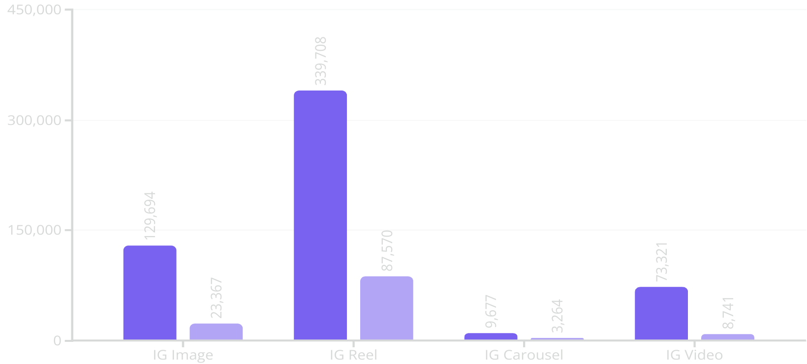
Impressions by Post Type
Analyzing impression ranges reveals IG Reels drive significantly higher reach, showcasing their broad appeal. Conversely, IG Carousel posts consistently yield the lowest impressions. Understanding these ranges is crucial for optimizing content formats to achieve desired audience visibility.
Max Impressions
Min Impressions

Slide 8
Filtering Weekend Posts for March and April
This query identifies all Instagram posts published on weekends during March and April, allowing for a focused analysis of content performance during these specific periods. The results can be exported to a CSV for further data processing.
SELECT * FROM fact_content f JOIN dim_dates d ON f.date = d.date WHERE weekday_or_weekend = 'Weekend' AND month_name IN ('March', 'April');
This query filters all posts published on weekends in March and April.

Slide 9
month_name
Total_profile_visits
Total_new_followers
January
26512
17053
February
20628
15254
March
23132
18285
April
29852
21799
May
106571
66984
June
103350
76942
July
54352
33302
August
42094
24371
September
41522
28523

Slide 10
Filtering Weekend Posts for March and April
Analyzing weekend post performance in March and April reveals significant growth in key engagement metrics.
March Weekend Performance
April Weekend Performance
369K
142K
687K
255K
Impressions
Reach
Impressions
Reach
Total views across all posts.
Unique accounts exposed to content.
Significantly higher total views.
Expanded unique audience reach.
12.3K
2.6K
28K
5.9K
Engagement
New Followers
Engagement
New Followers
Likes, comments, shares, and saves combined.
Audience growth during weekends.
Strong increase in user interaction.
Substantial boost in follower acquisition.

Slide 11
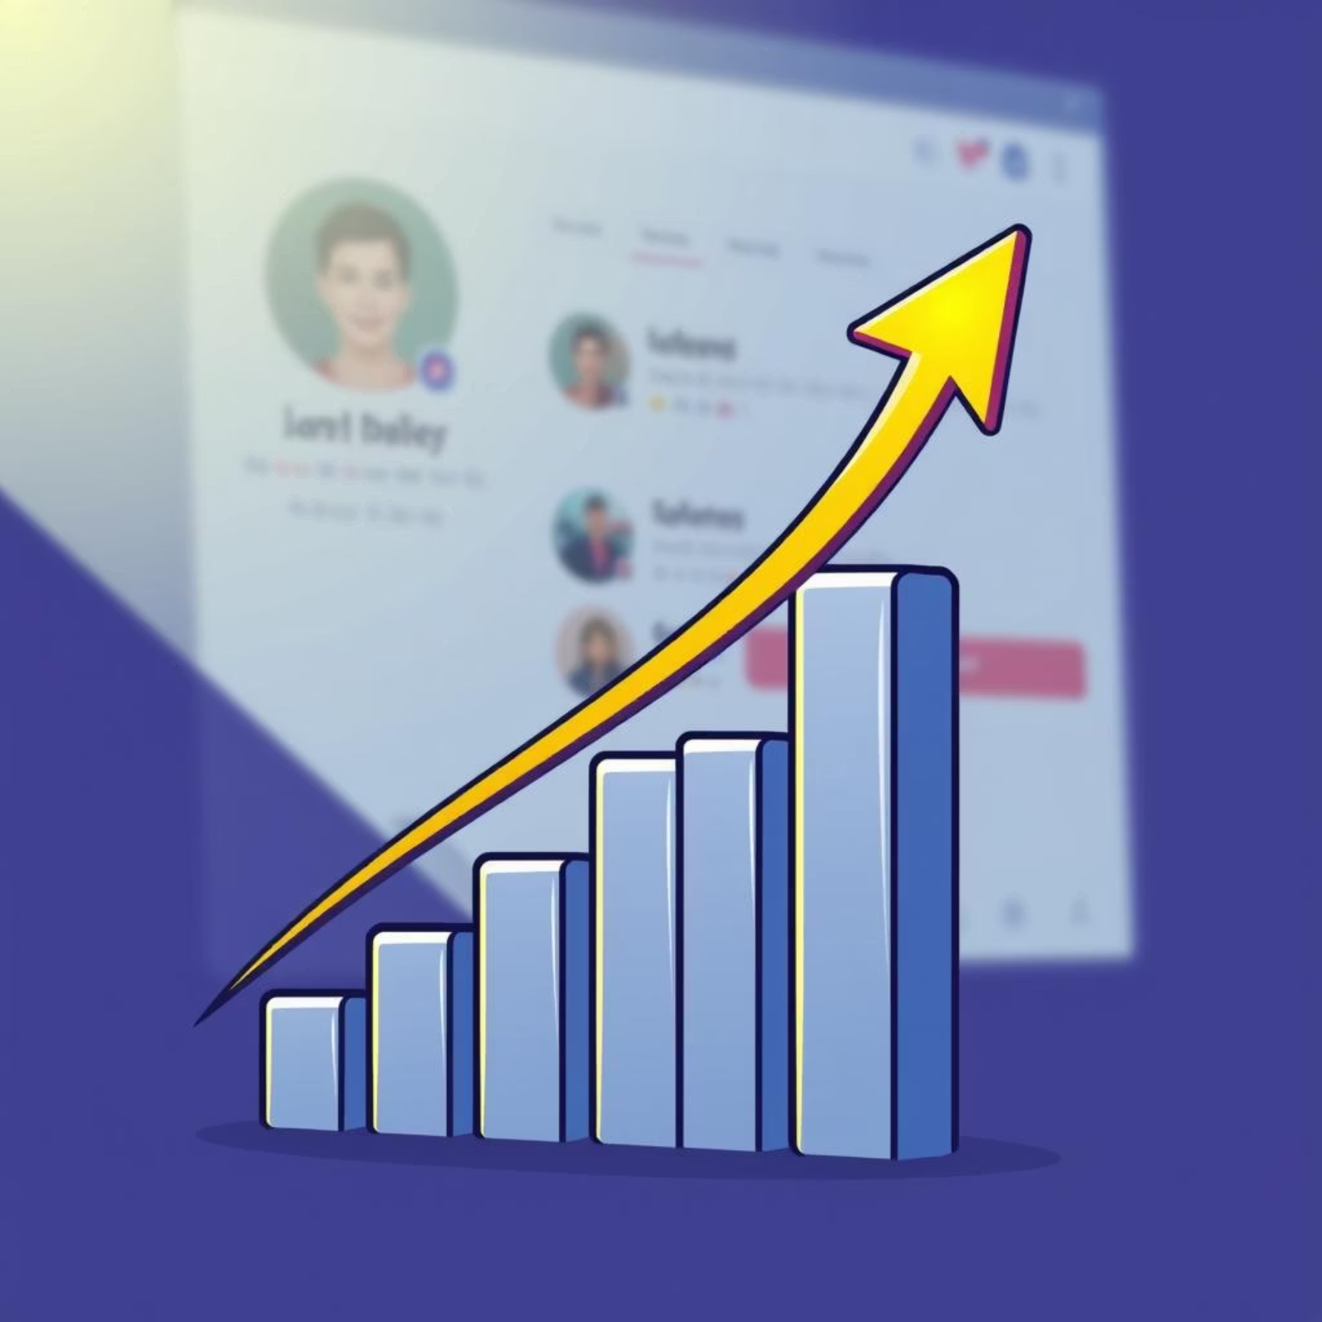
Audience Growth and Engagement
Analyzing profile visits and new followers provides crucial insights into audience acquisition and overall account performance.
448013
302513
Total Profile Visits
Total New Followers
Sum of all profile visits recorded across the dataset, indicating overall interest in the account.
Aggregate of new followers gained, reflecting the account's growth over time.
Account Statistics by Month
SELECT d.month_name, SUM(f.profile_visits) AS total_profile_visits, SUM(f.new_followers) AS total_new_followersFROM dim_dates dJOIN fact_account f ON d.date = f.dateGROUP BY d.month_name;

Slide 12

Optimizing Content Engagement
Delving into post performance metrics, such as likes and reach, helps refine our content strategy for maximum impact.
1
Top Performing Categories (July)
Using a CTE, we identify post categories with the highest total likes in July, highlighting successful content themes.
WITH post_category_like AS ( SELECT f.post_category, SUM(f.likes) AS total_likes FROM fact_content f JOIN dim_dates d ON f.date = d.date WHERE d.month_name = 'July' GROUP BY f.post_category)SELECT post_category, total_likesFROM post_category_likeORDER BY total_likes DESC;

Slide 13
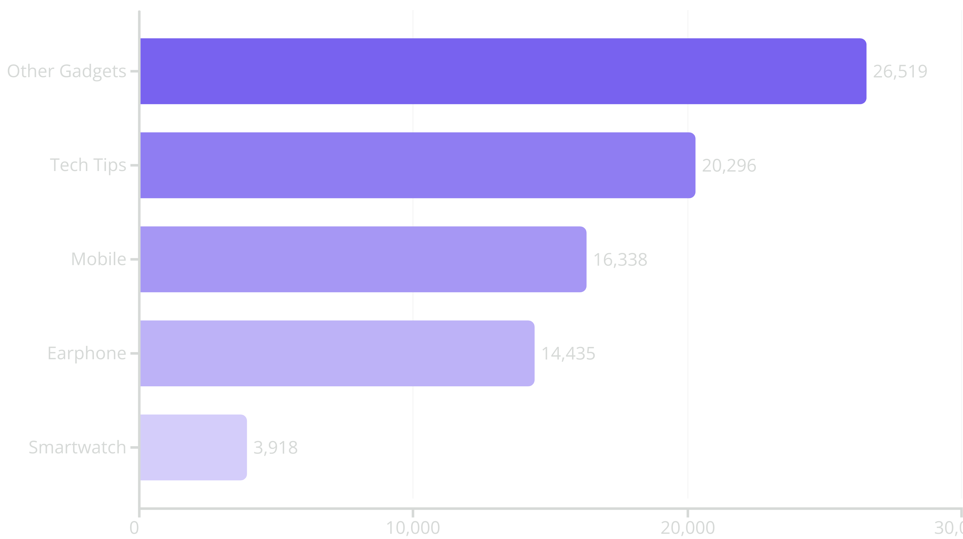
Top Performing Categories (July)

Slide 14
Categorizing Content Over Time
This query provides a consolidated view of unique content categories posted each month, along with the total count of distinct categories. This helps identify content diversification trends and dominant themes over time.
SELECT d.month_name, GROUP_CONCAT(DISTINCT f.post_category ORDER BY f.post_category SEPARATOR ',') AS post_category_names, COUNT(DISTINCT f.post_category) AS unique_category_countFROM fact_content f JOIN dim_dates d ON f.date = d.date GROUP BY d.month_nameORDER BY d.month_name;

Slide 15

month_name
post_category
category_count
April
Earphone,Laptop,Mobile,Other Gadgets,Smartwatch
5
August
Earphone,Mobile,Other Gadgets,Smartwatch,Tech Tips
5
February
Earphone,Laptop,Mobile,Smartwatch
4
January
Earphone,Mobile,Smartwatch
3
July
Earphone,Mobile,Other Gadgets,Smartwatch,Tech Tips
5
June
Mobile,Other Gadgets,Smartwatch,Tech Tips
4
March
Earphone,Laptop,Mobile,Smartwatch
4
May
Earphone,Laptop,Mobile,Other Gadgets,Smartwatch,Tech Tips
6
September
Mobile,Other Gadgets,Smartwatch,Tech Tips
4

Slide 16
Percentage breakdown of total reach by post type
This query calculates the total reach and the percentage breakdown of reach for each Instagram post type, providing insights into which content formats are most effective in extending our audience's exposure.
SELECT post_type, SUM(reach) AS total_reach, ROUND(SUM(reach) * 100.0 / (SELECT SUM(reach) FROM fact_content), 2) AS reach_percentageFROM fact_contentGROUP BY post_type;

Slide 17
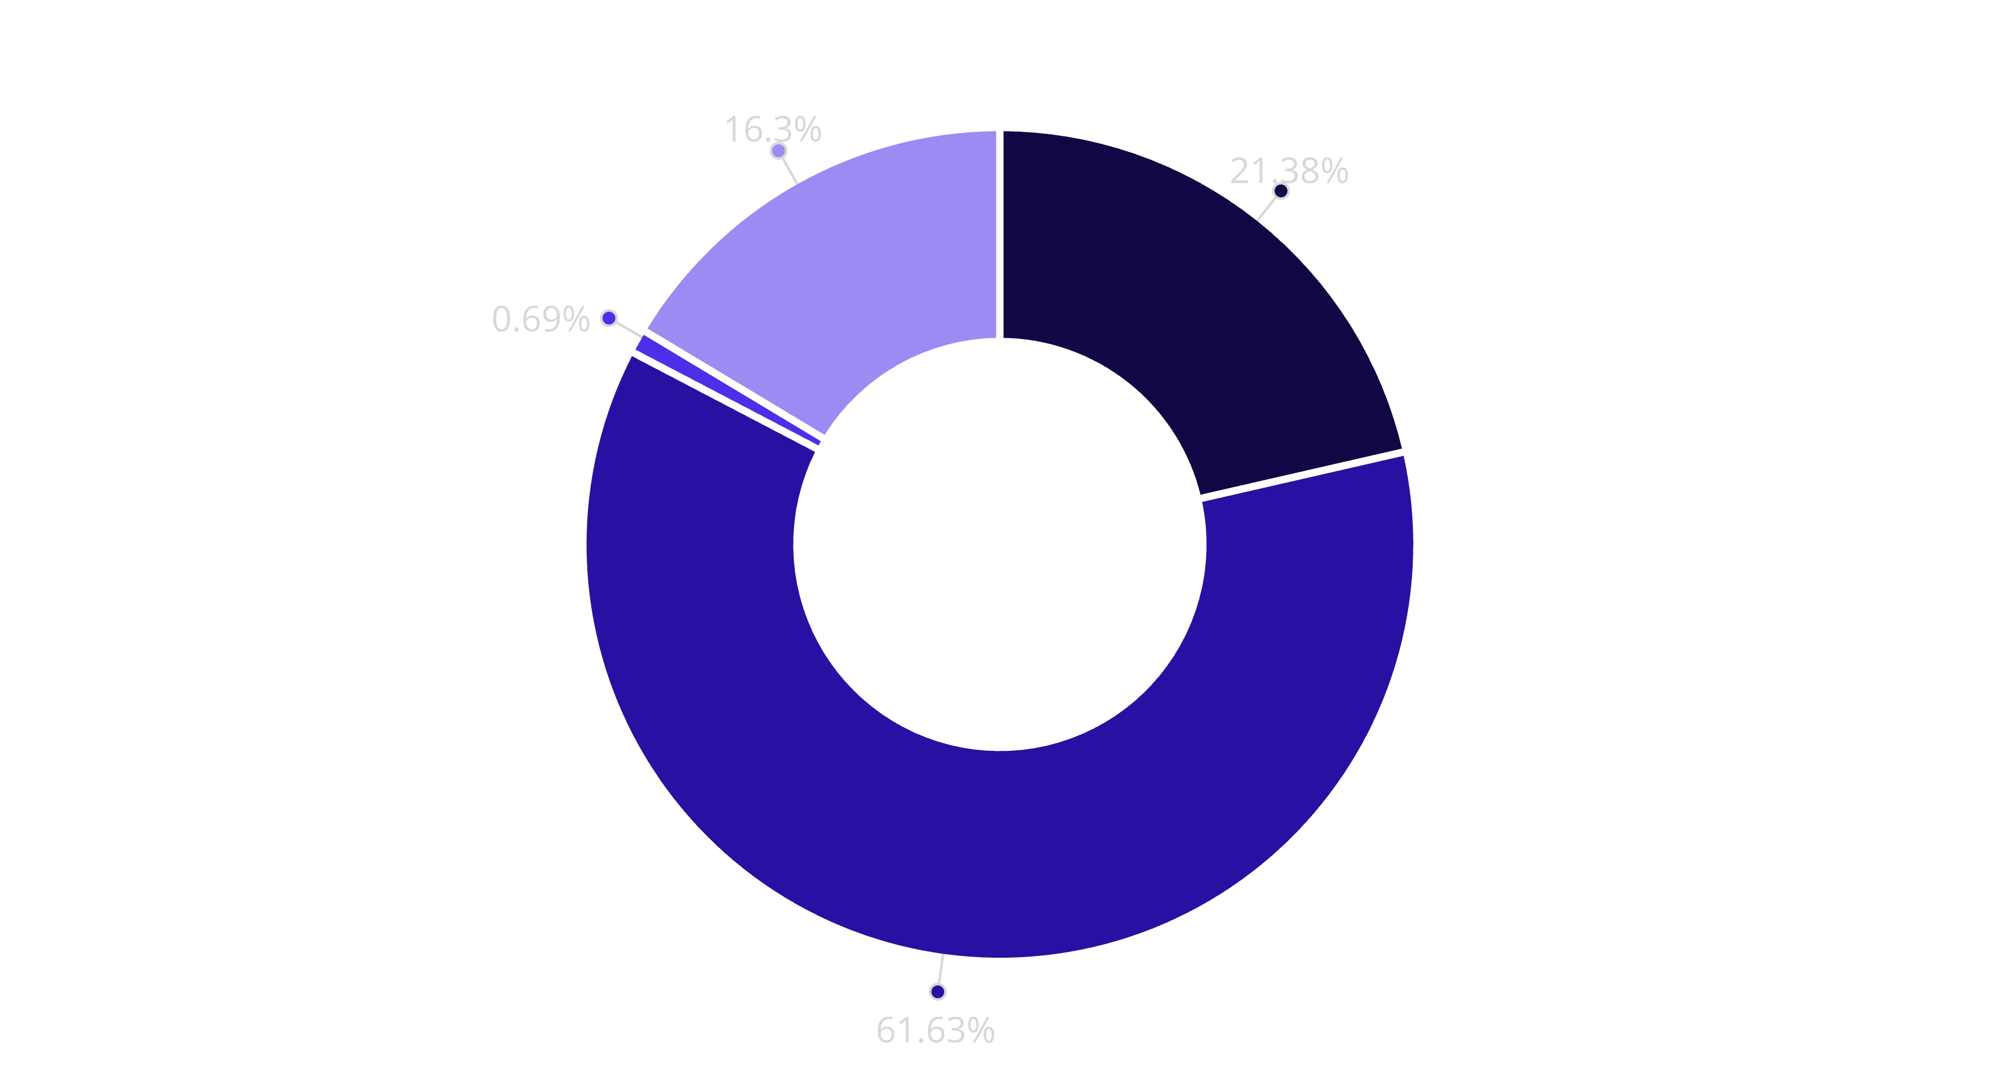
Total Reach Percentage by Post Type
IG Image
IG Reel
IG Carousel
IG Video

Slide 18
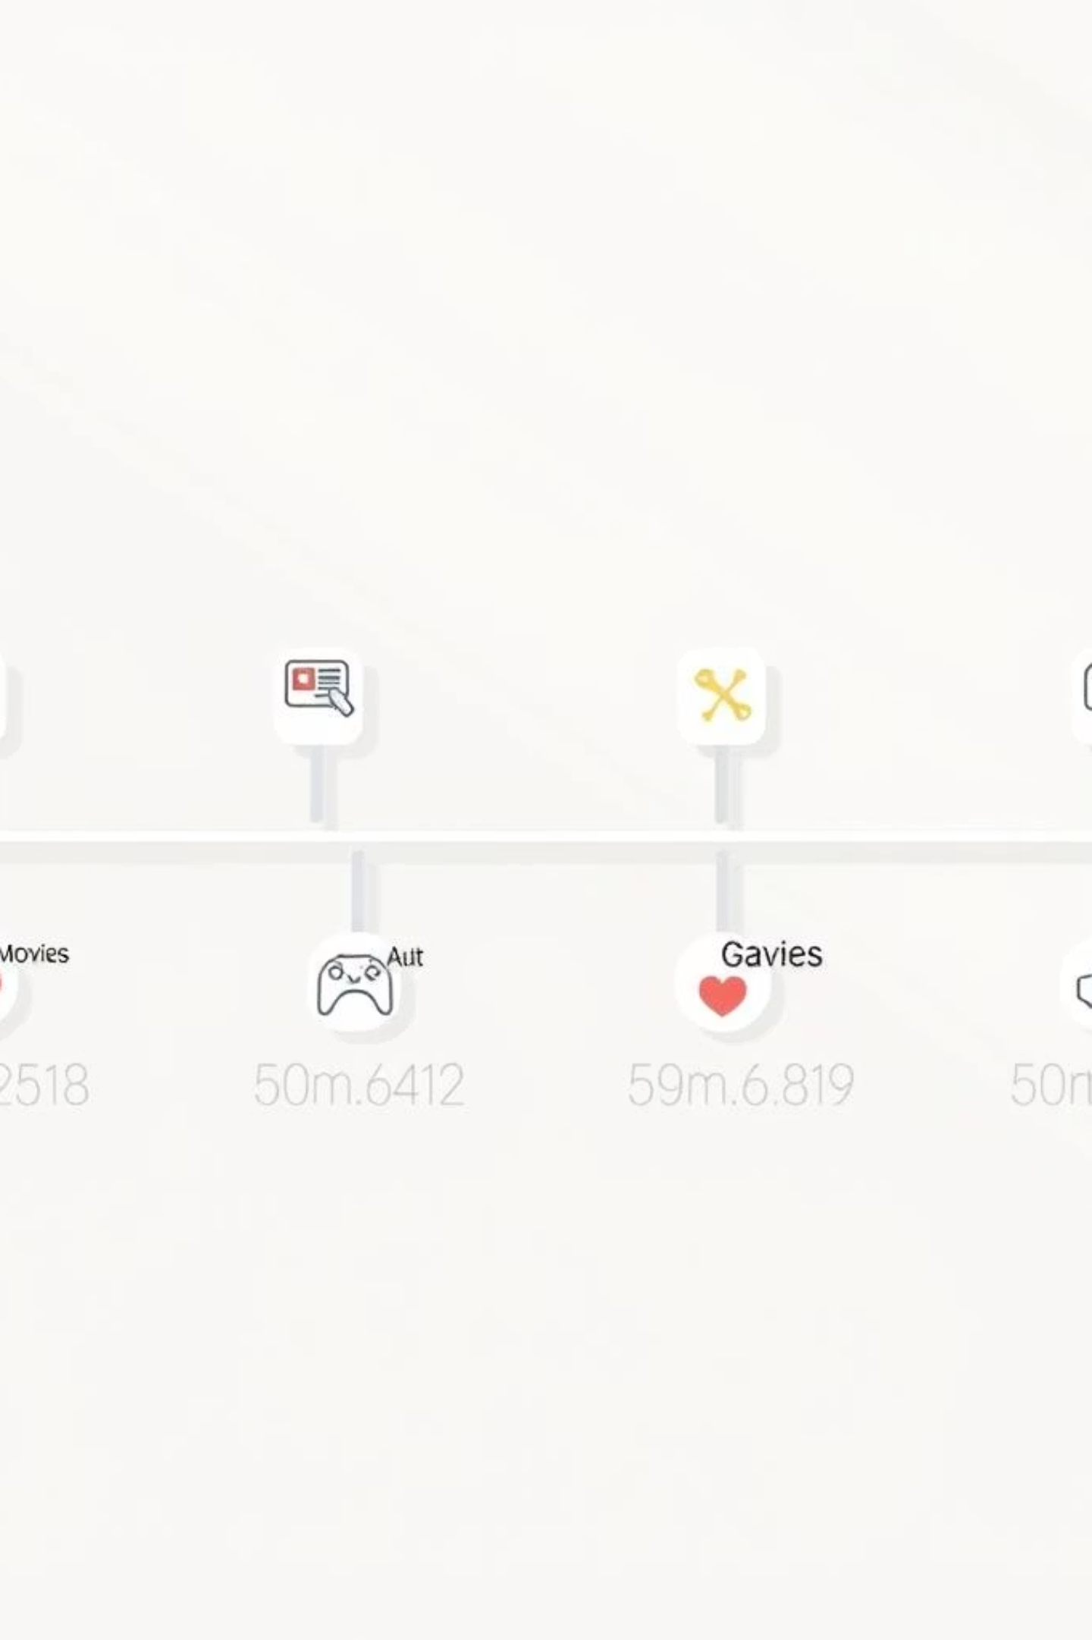


Quarterly Performance Review
Grouping content performance by quarter allows for broader trend analysis and strategic planning.
Step 1: Quarter Mapping
We first enrich the dim_dates table by adding and updating a 'quarter' column to categorize months appropriately.
ALTER TABLE dim_dates ADD COLUMN quarter VARCHAR(10);UPDATE dim_dates SET quarter = CASE WHEN month_name IN ('January', 'February', 'March') THEN 'Q1' WHEN month_name IN ('April', 'May', 'June') THEN 'Q2' WHEN month_name IN ('July', 'August', 'September') THEN 'Q3' ELSE 'Q4'END;
Step 2: Generate Report
This query provides a quarterly breakdown of comments and saves per post category, offering a seasonal perspective on engagement.
SELECT f.post_category, d.quarter, SUM(f.comments) AS total_comments, SUM(f.saves) AS total_savesFROM fact_content fJOIN dim_dates d ON f.date = d.dateGROUP BY f.post_category, d.quarter;

Slide 19
post_category
quarter
Total_Comments
Total_Saves
Mobile
Q1
48
9843
Smartwatch
Q1
1
2860
Earphone
Q1
29
2230
Laptop
Q1
26
2837
Mobile
Q2
1
17207
Earphone
Q2
22
3602
Smartwatch
Q2
41
12581
Other Gadgets
Q2
14
12041
Laptop
Q2
101
2248
Tech Tips
Q2
198
17649
Other Gadgets
Q3
43
4457
Smartwatch
Q3
26
3326
Earphone
Q3
21
3247
Tech Tips
Q3
113
12976
Mobile
Q3
20
5285

Slide 20
Top 3 Dates per Month by New Followers
This query identifies the top 3 dates each month based on the highest number of new followers gained, providing insight into which specific days drive the most audience growth.
SELECT month_name,date,new_followersFROM ( SELECT d.month_name, f.date, s.new_followers, ROW_NUMBER() OVER (PARTITION BY d.month_name ORDER BY s.new_followers DESC) AS rn FROM fact_content f JOIN dim_dates d ON f.date = d.date JOIN fact_account s ON f.date = s.date) tWHERE rn <= 3ORDER BY month_name,new_followers DESC;

Slide 21
Top Dates by New Followers
This table highlights the specific dates each month that generated the highest number of new followers, providing insights into optimal posting times or content impact on audience growth.
Month
Date
New Followers
April
25-04-2023
3736
April
30-04-2023
2753
April
06-04-2023
2500
August
23-08-2023
2074
August
21-08-2023
1783
August
06-08-2023
1687
February
01-02-2023
4106
February
24-02-2023
2383
February
02-02-2023
1989
January
30-01-2023
3186
January
03-01-2023
2959
January
23-01-2023
1003
July
08-07-2023
3716
July
15-07-2023
3364
July
28-07-2023
2344
June
30-06-2023
8804
June
03-06-2023
8802
June
21-06-2023
7033
March
21-03-2023
5421
March
28-03-2023
2513
March
25-03-2023
2356
May
08-05-2023
8872
May
20-05-2023
6169
May
12-05-2023
6051
September
16-09-2023
3849
September
22-09-2023
3570
September
21-09-2023
2285

Slide 22
Stored Procedure for Weekly Shares Report
This stored procedure takes the 'Week_no' as input and generates a report displaying the total shares for each 'Post_type'.
CREATE DEFINER=`root`@`localhost` PROCEDURE `Get_Shares_ByWeek`(IN input_week varchar(4))BEGIN SELECT f.post_type, SUM(f.shares) AS total_shares FROM fact_content f JOIN dim_dates d ON f.date = d.date WHERE d.week_no = input_week GROUP BY f.post_type;ENDcall gdb0120.Get_Shares_ByWeek('W15');

Slide 23
Total Shares by Post Type – Week 15
Post Type
Total Shares
IG Image
449
IG Video
569
IG Reel
955
IG Carousel
11

Slide 24




Key Takeaways and Next Steps
Our SQL analysis reveals actionable insights for optimizing Instagram strategy and engaging our audience more effectively.
Growth Trends
Monthly new followers and profile visits show clear growth patterns, indicating effective audience acquisition strategies.
Engagement Hotspots
Specific post categories and types drive higher likes, comments, and saves, indicating content that resonates most with the audience.
Seasonal Content
Quarterly and monthly reports highlight seasonal content trends and their impact on engagement and reach.
Next Steps:
Deep dive into content that generated highest engagement.
Experiment with A/B testing different post types.
Refine content calendar based on quarterly insights.

